Slide 1

Humans and the carbon cycle
Priyanjana Pramanik
@ahappypanna
Artwork © Mimi Hi

Slide 2
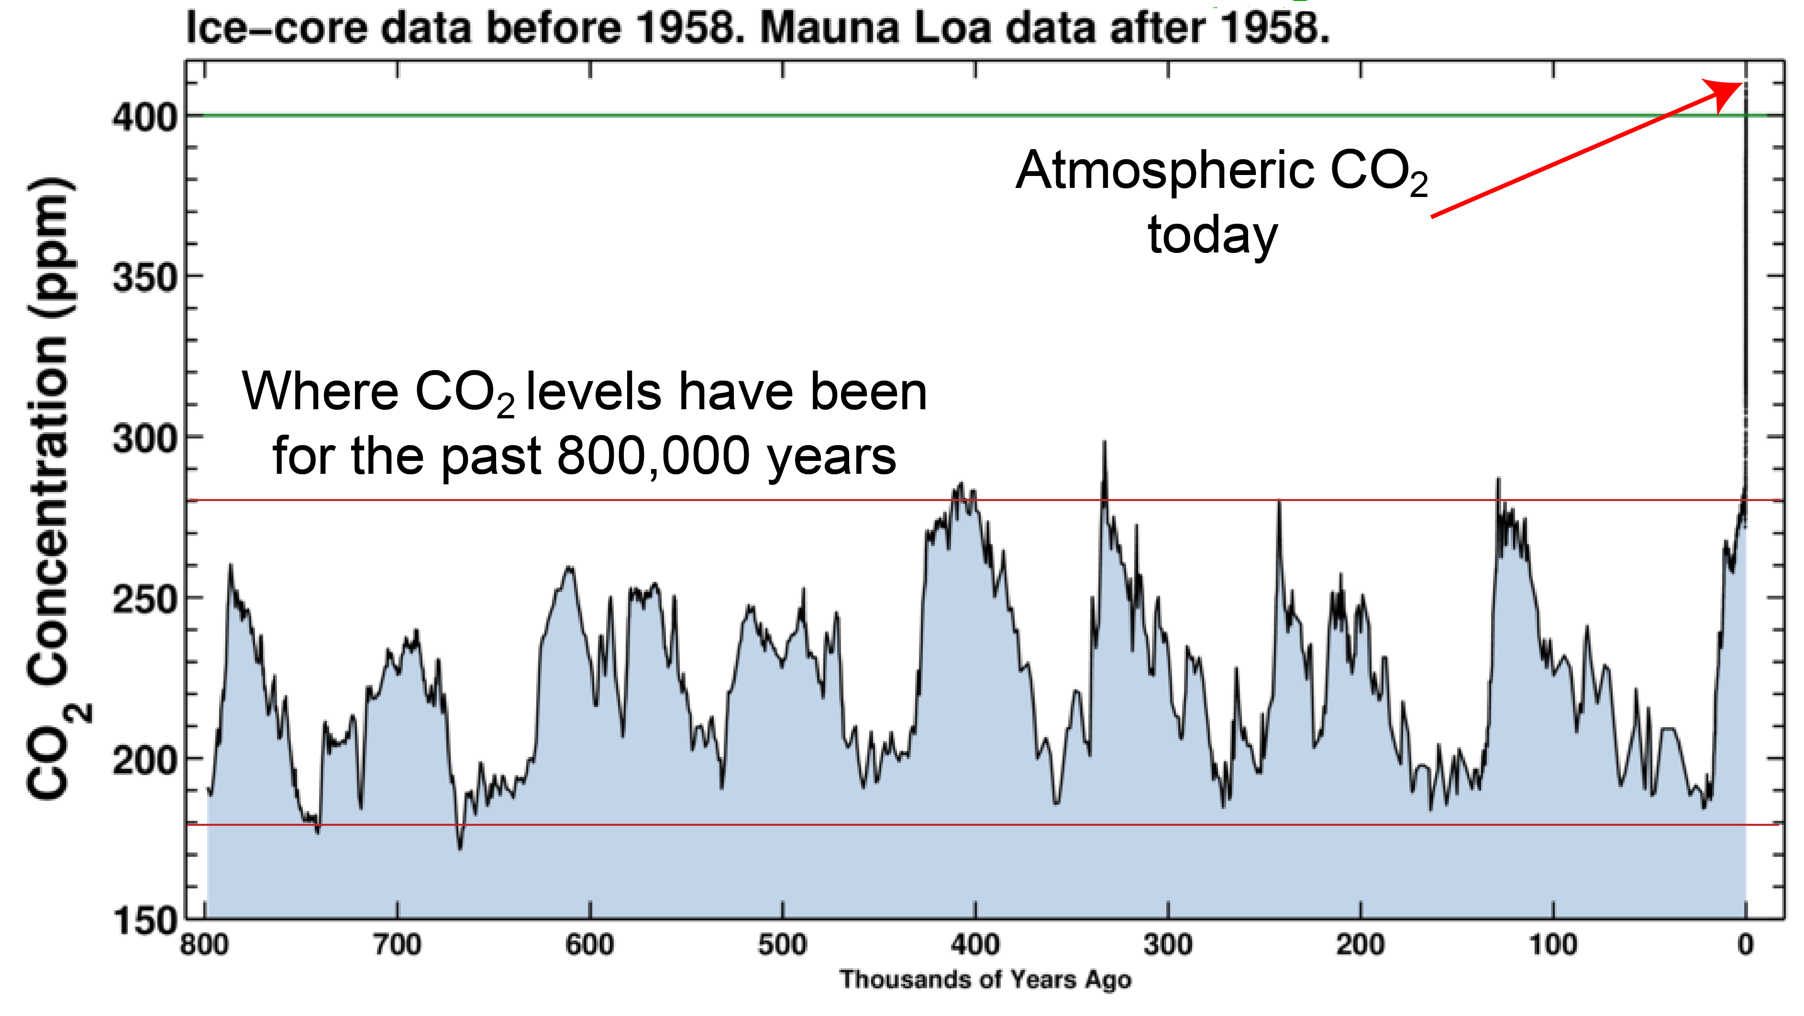

Slide 3
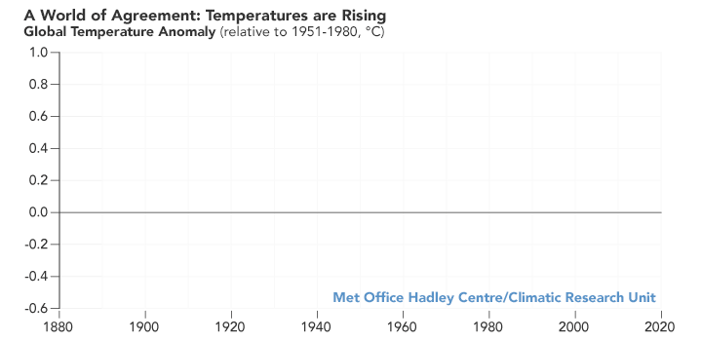

Slide 4
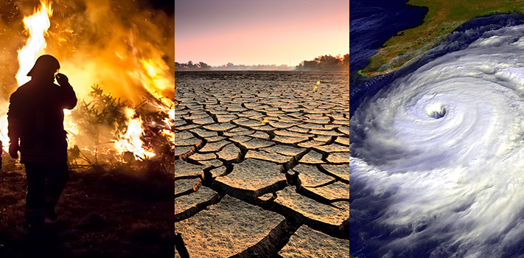
And then?

Slide 5
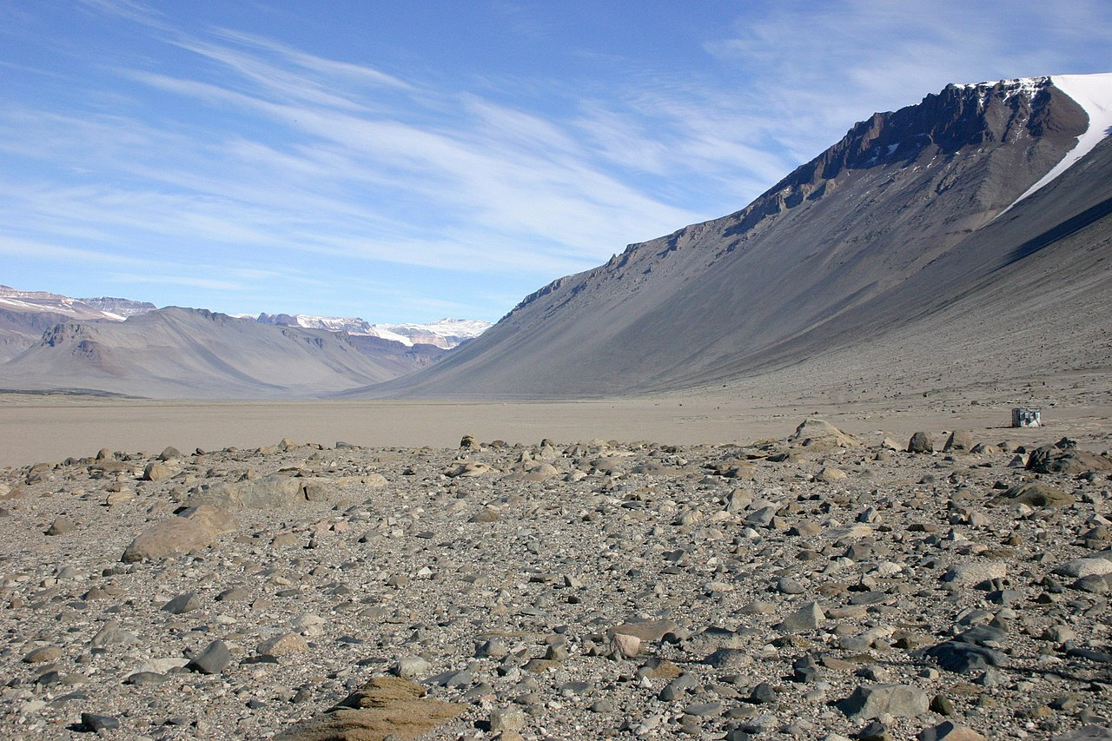

Slide 6
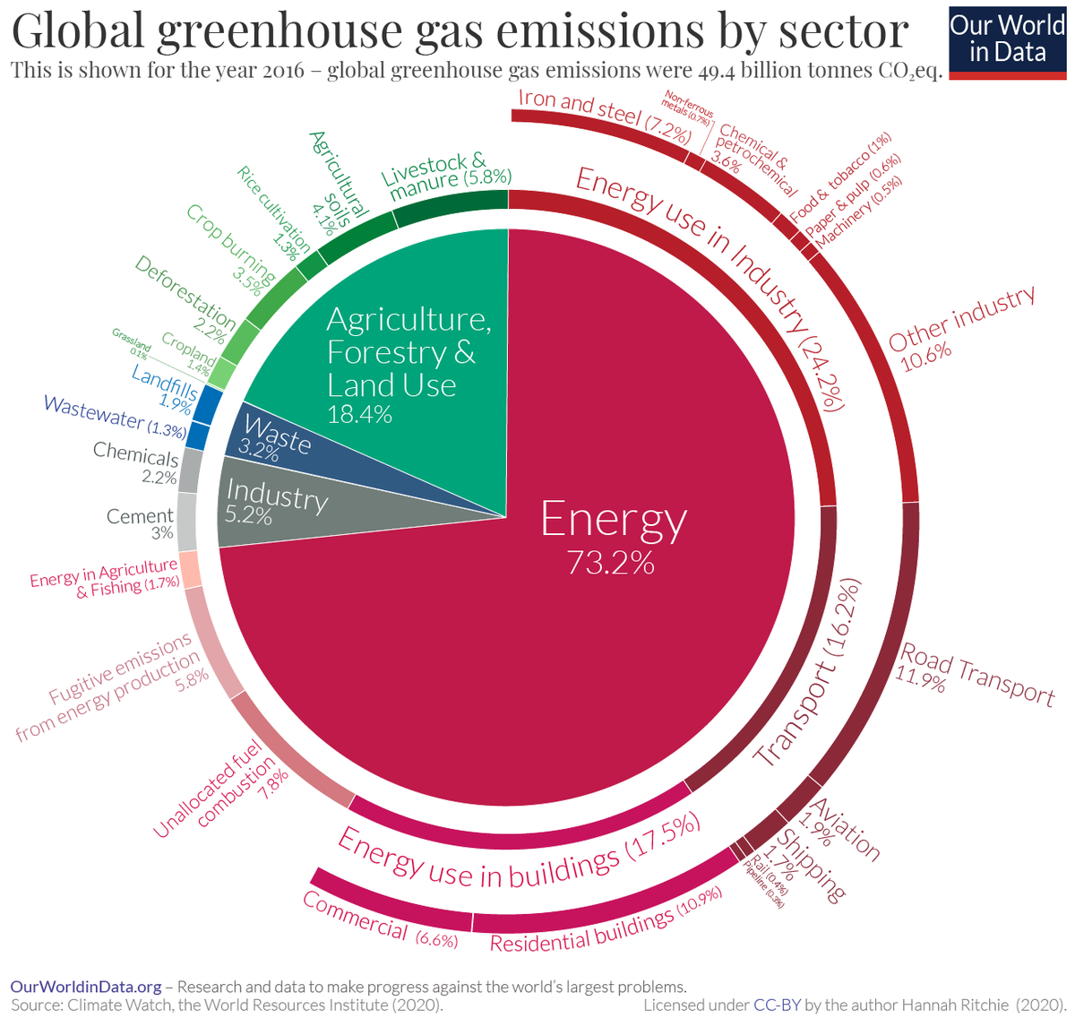
Carbon sources
Emit more carbon dioxide than they absorb
Increase the amount of carbon dioxide in the atmosphere
Examples: burning of fossil fuels, deforestation, volcanic eruptions

Slide 7
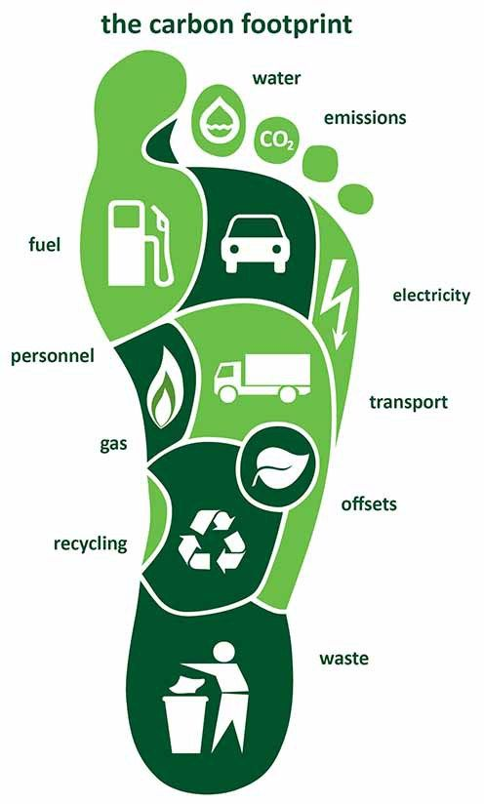
Carbon footprint
The total amount of greenhouse gases (including carbon dioxide and methane) that are generated by our actions
How much electricity did I use?
How much fuel did I use to travel?
How much waste did I generate?

Slide 8
Institutional carbon footprint
How much electricity did everyone in that institution use?
How much fuel was used to travel to/from that institution?
How much waste was generated from that institution?

Slide 9

Personal vs. institutional

Slide 10
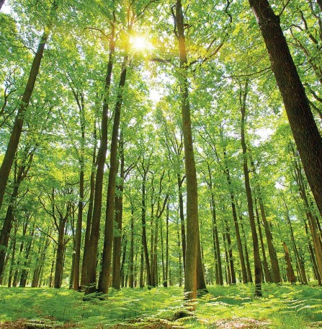
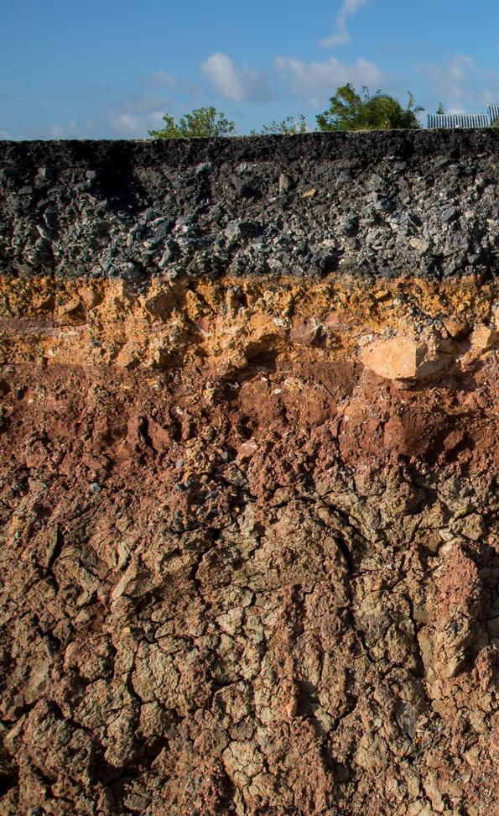

Carbon sinks

Slide 11

An introduction to plants
Priyanjana Pramanik
@ahappypanna
Background ©@nataslavetskaya

Slide 12
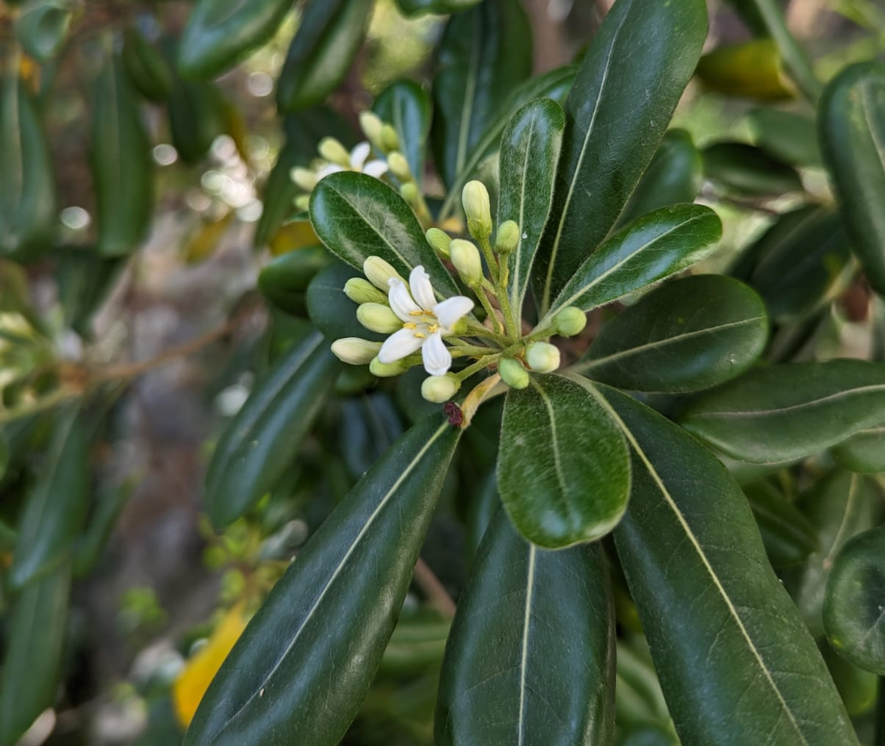
Kingdom: Plantae
400,000 species of ‘vascular’ plants
94% produce flowers
Almost all (except ferns) produce seeds
~2000 species are discovered every year
1 in 5 are threatened with extinction

Slide 13

Posidonia australis – 4,500 years old – 200 sq. km.

Slide 14
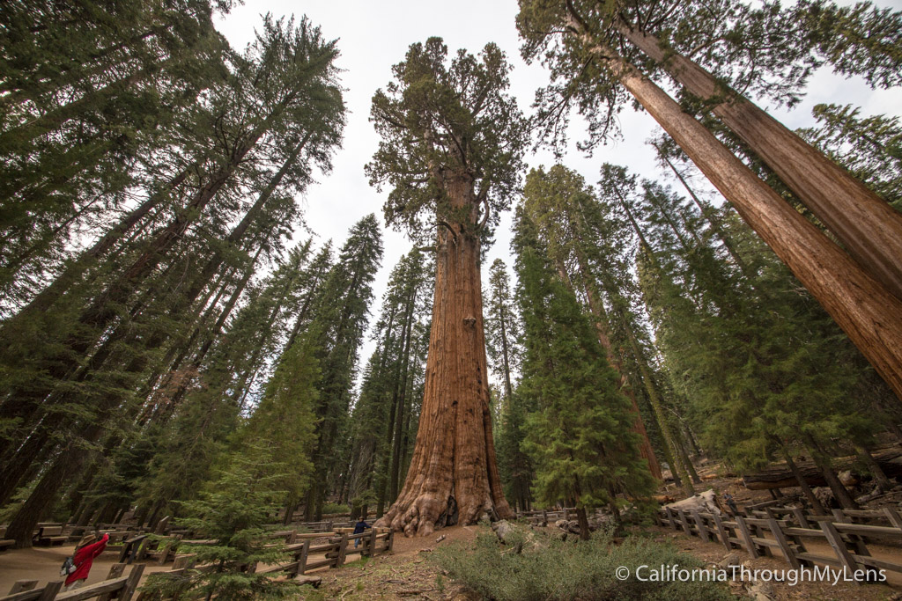
General Sherman – 2,200 years old – 275 feet

Slide 15
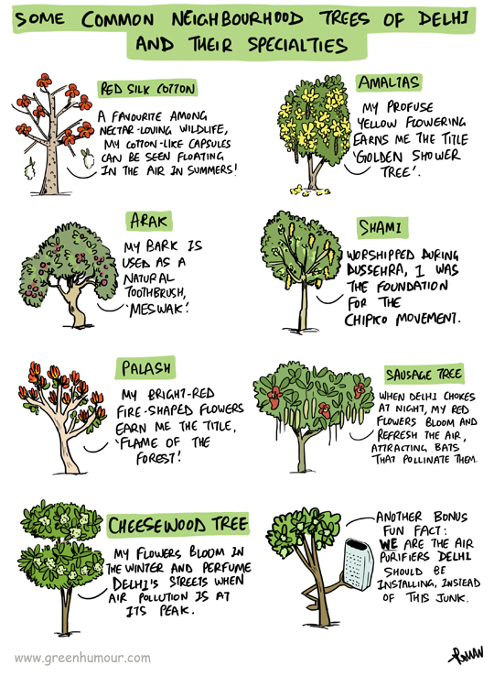

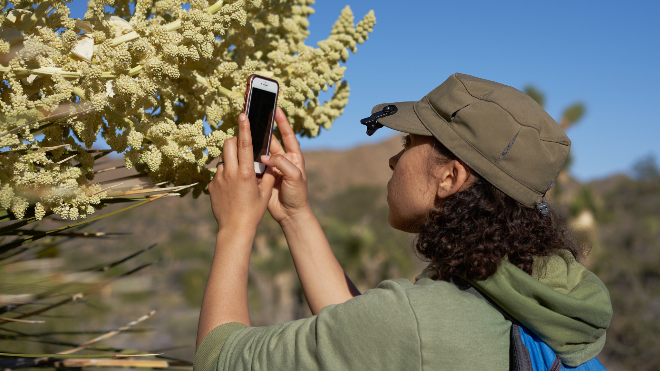

How do we identify plants?
Observation
Ask somebody!
Scientific names/common names
Field guides
Online resources: iNaturalist etc.

Slide 16
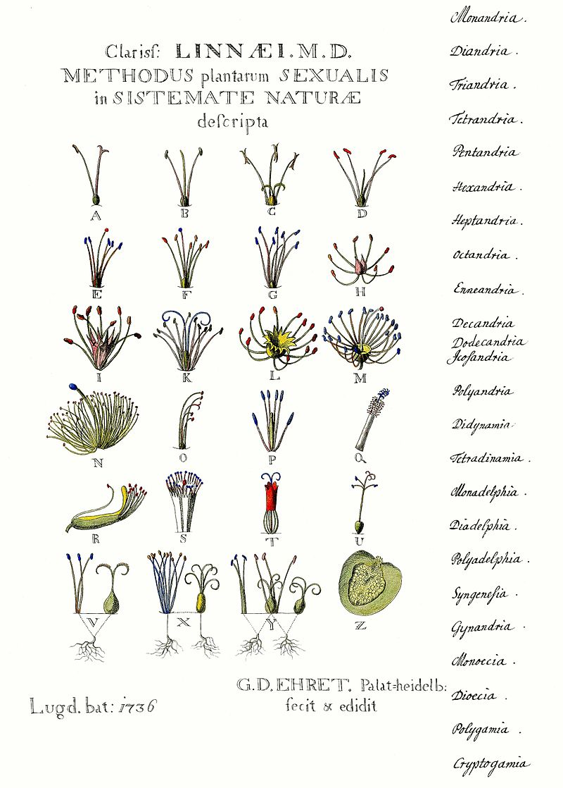
Plant classification
Carl Linnaeus
Binomial nomenclature (Genus species)
Grouping based on similarities
Kingdom, division, class, order, family

Slide 17

Observation
Woody or non-woody?
Tree, shrub, or woody vine?
Fruiting? Flowering?
Leaves
Bark
Fruits
Flowers

Slide 18
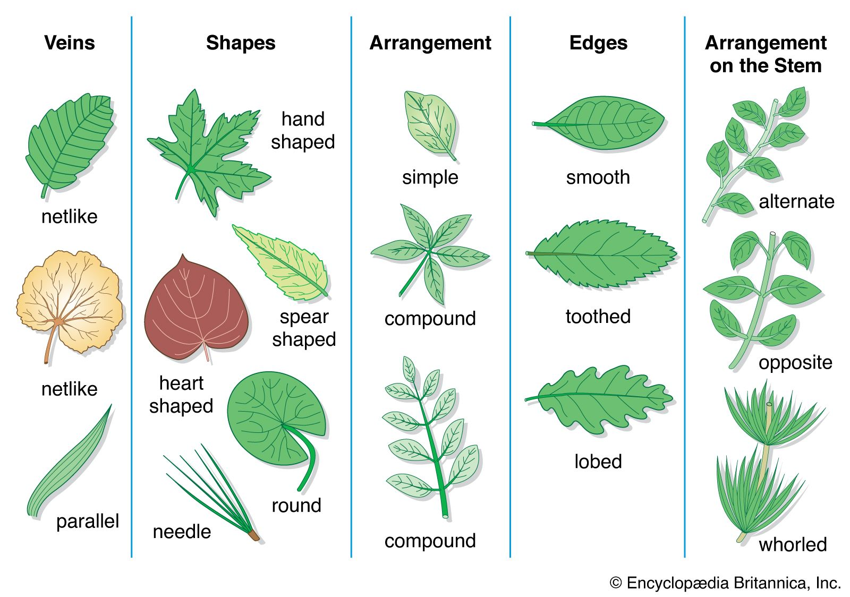
Leaves

Slide 19
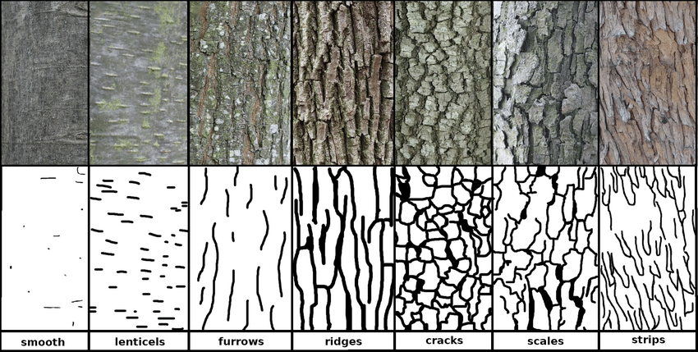
Bark

Slide 20
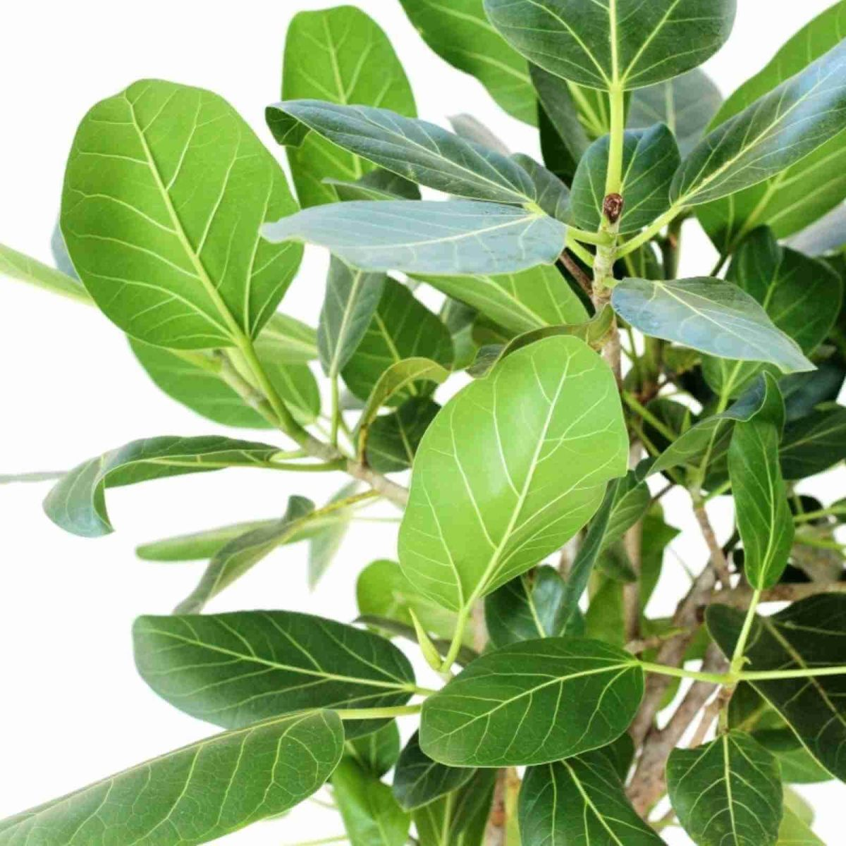
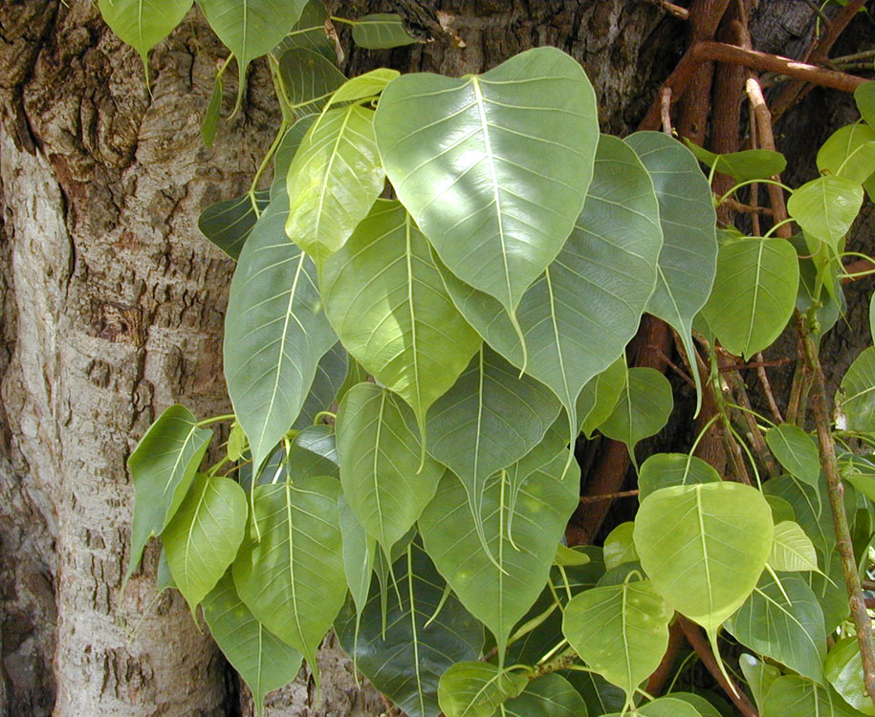
Fig family or Moraceae

Slide 21
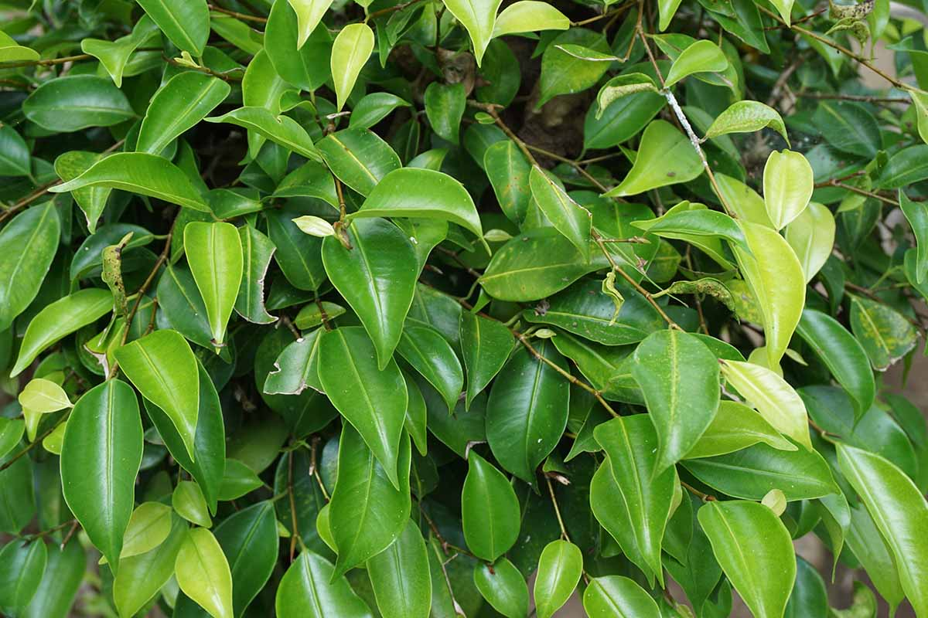
Species: Ficus
Mostly evergreen
Simple, waxy leaves
Exude white or yellow latex when broken
Aerial roots
Can be epiphytic

Slide 22
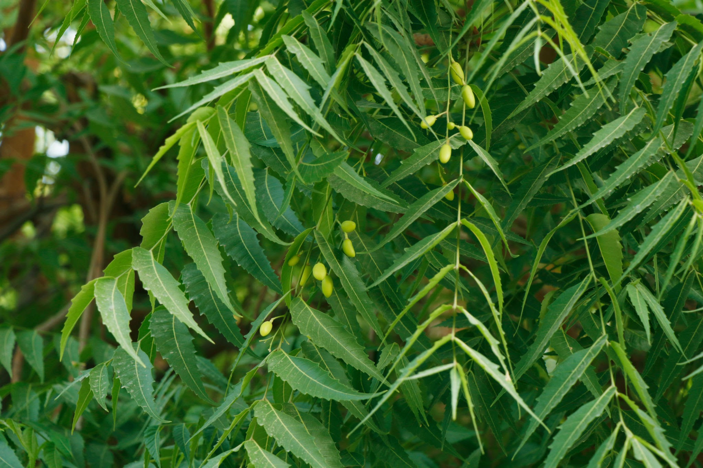
Mahogany family or Meliaceae
Mostly evergreen
Pinnate leaves
Flowers can be in clusters
Mostly woody trees, not shrubs
Characteristic smell

Slide 23
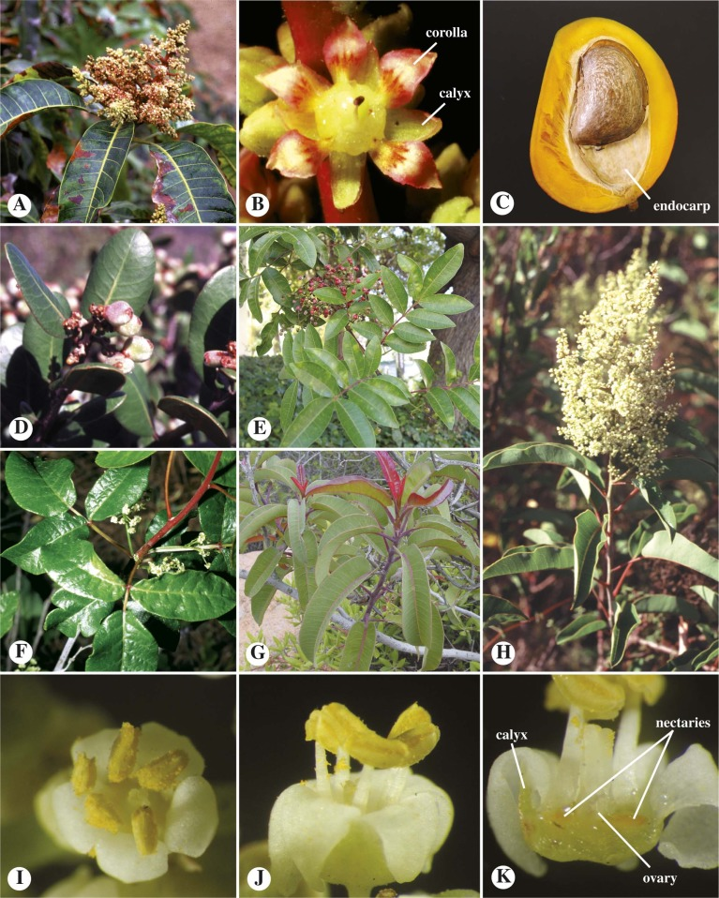
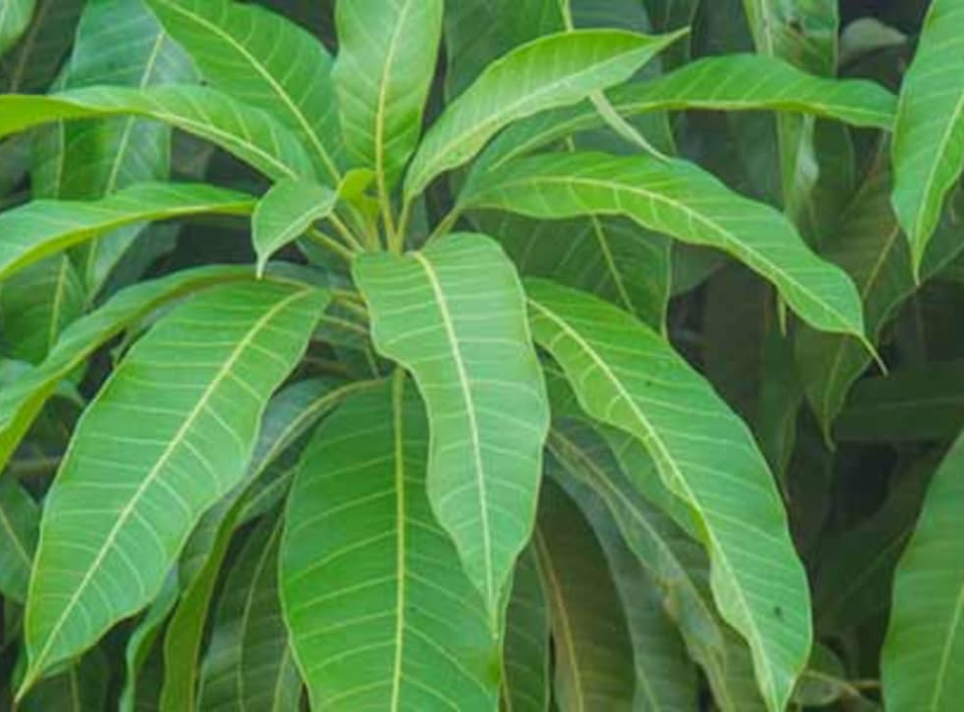
Cashew family or Anacardiaceae

Slide 24
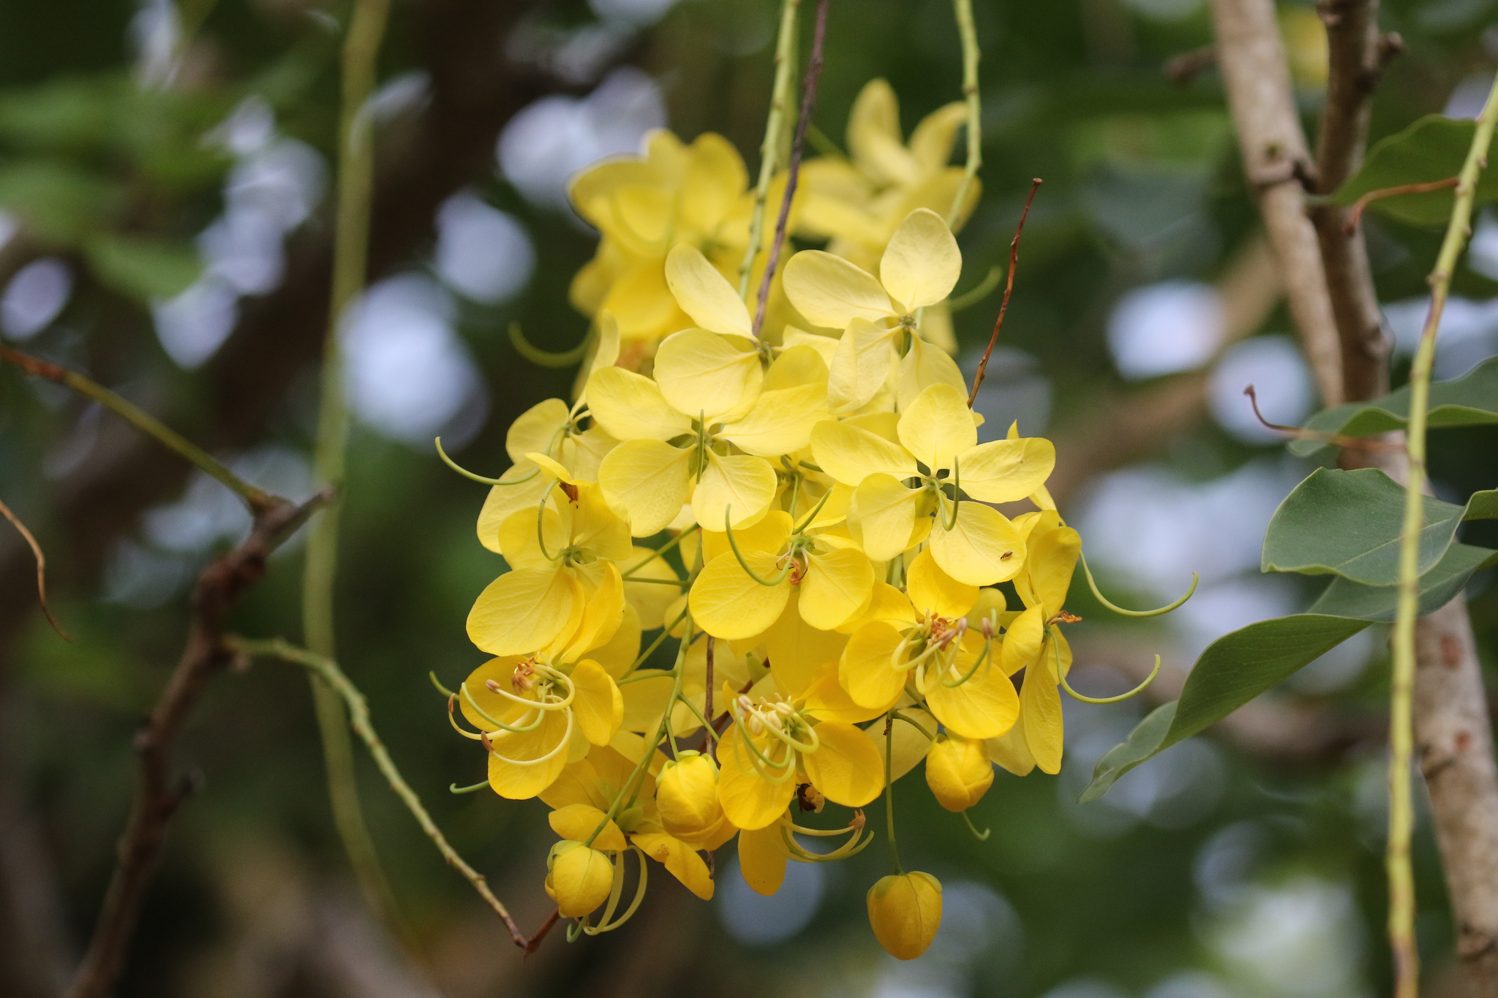
Pea family or Fabaceae
Legumes
Fruits: ovate or elongated, and are generally flattened
Seeds bean-like
Surrounded by sweet-tasting flesh.

Slide 25
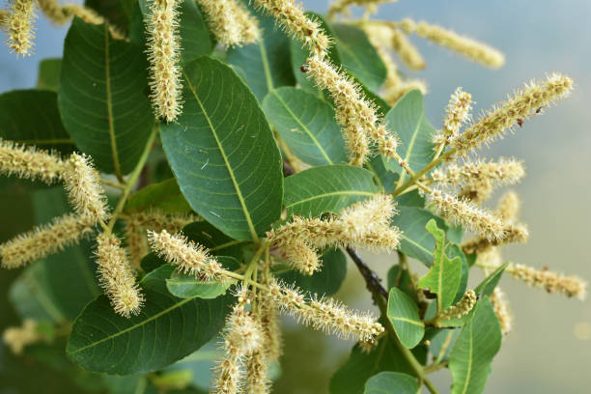
White mangrove family or Combretaceae

Slide 26
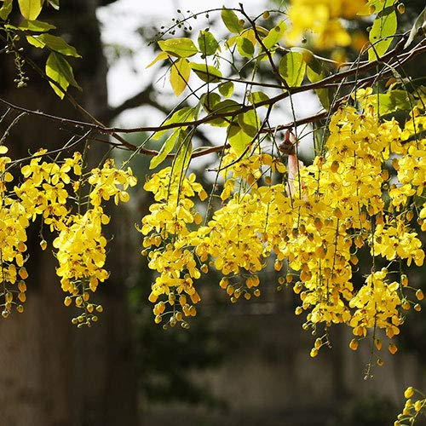
Native

Slide 27
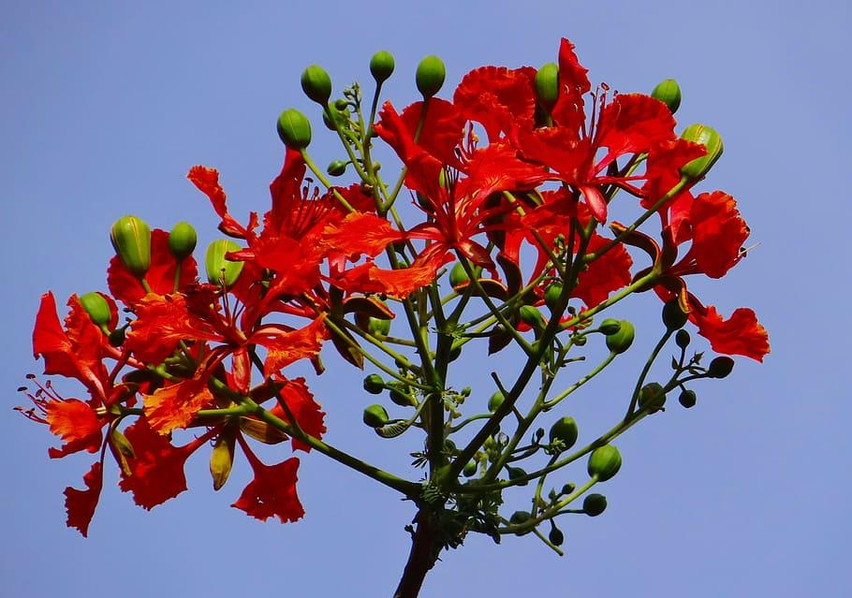
Introduced species

Slide 28
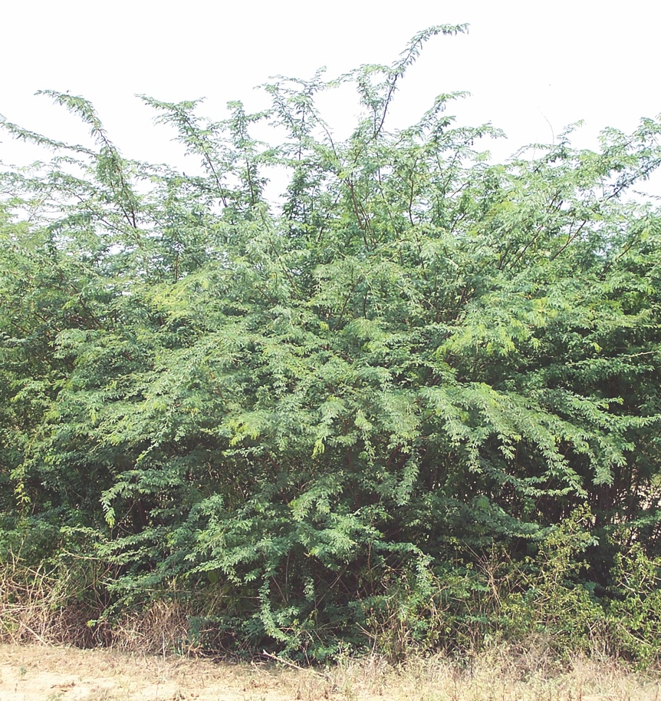
Invasive

